Slide 1
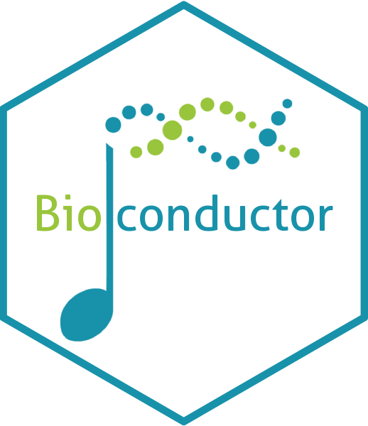
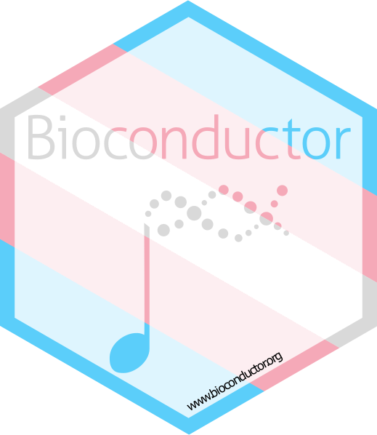
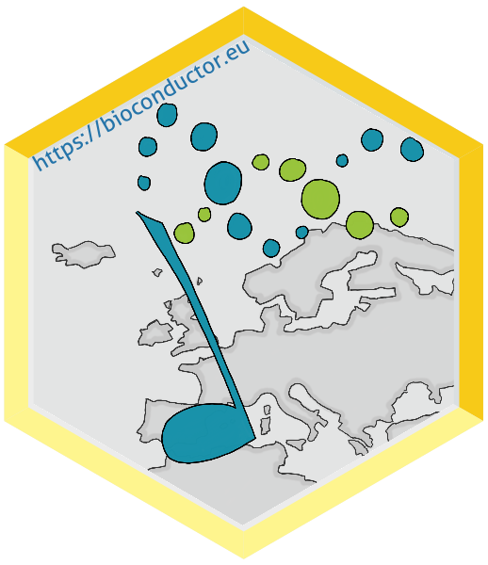
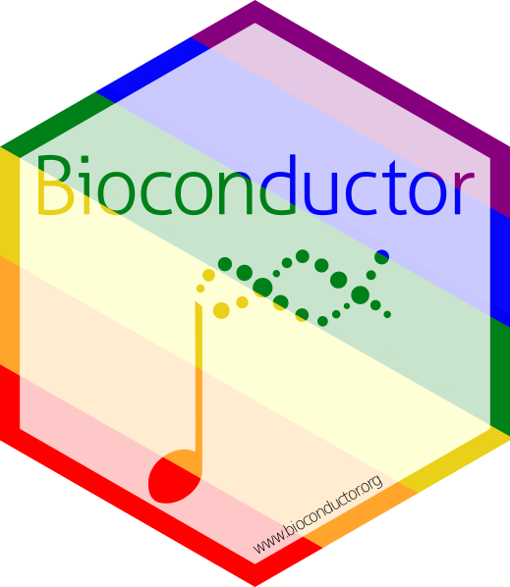
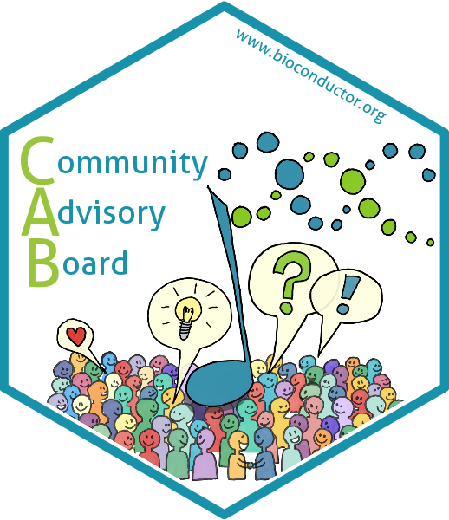
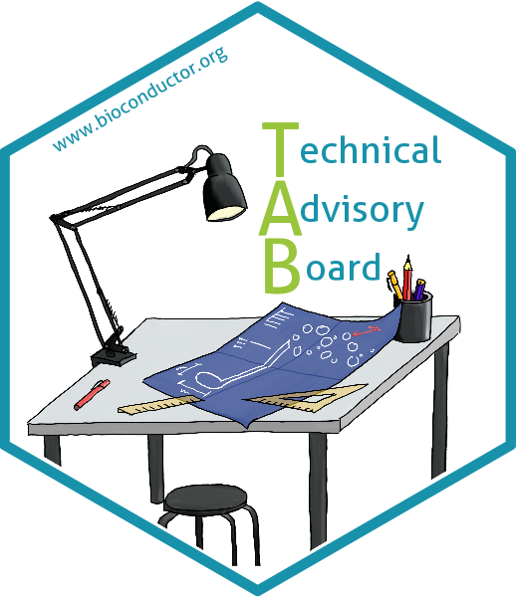
The Bioconductor Community Advisory Board
Dr Maria Doyle, Prof Aedin Culhane
University of Limerick, Ireland
YERUN Award
Feb 14th 2024

Slide 2
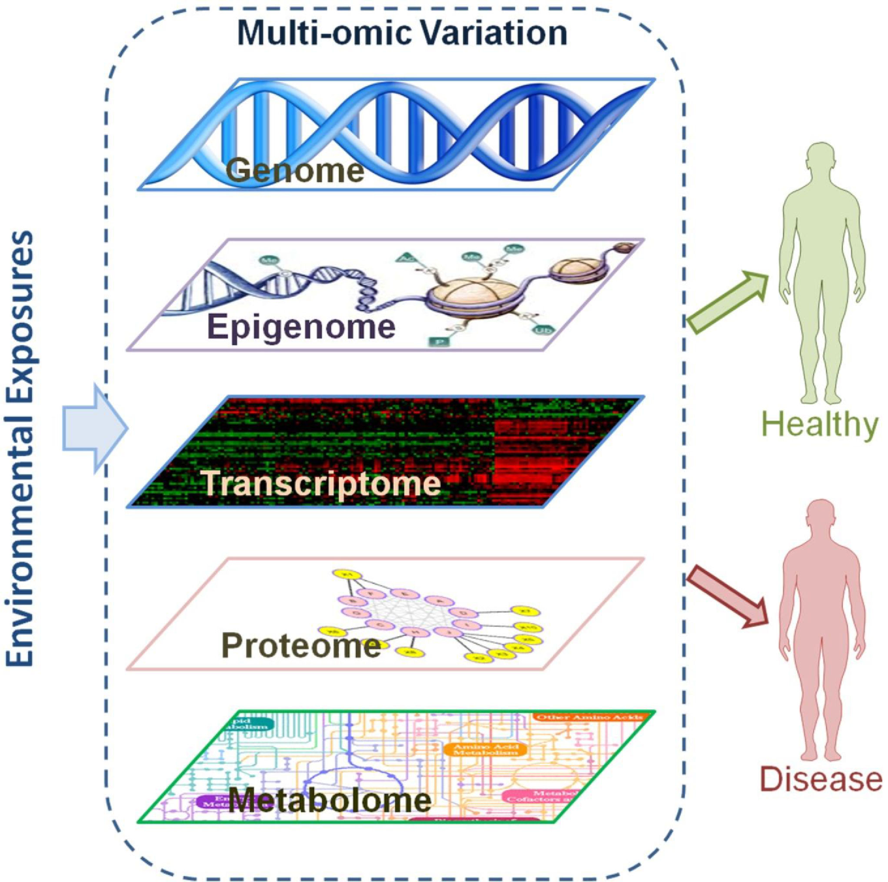
Bioconductor is a community-led open source software project advancing biological discovery

Slide 3
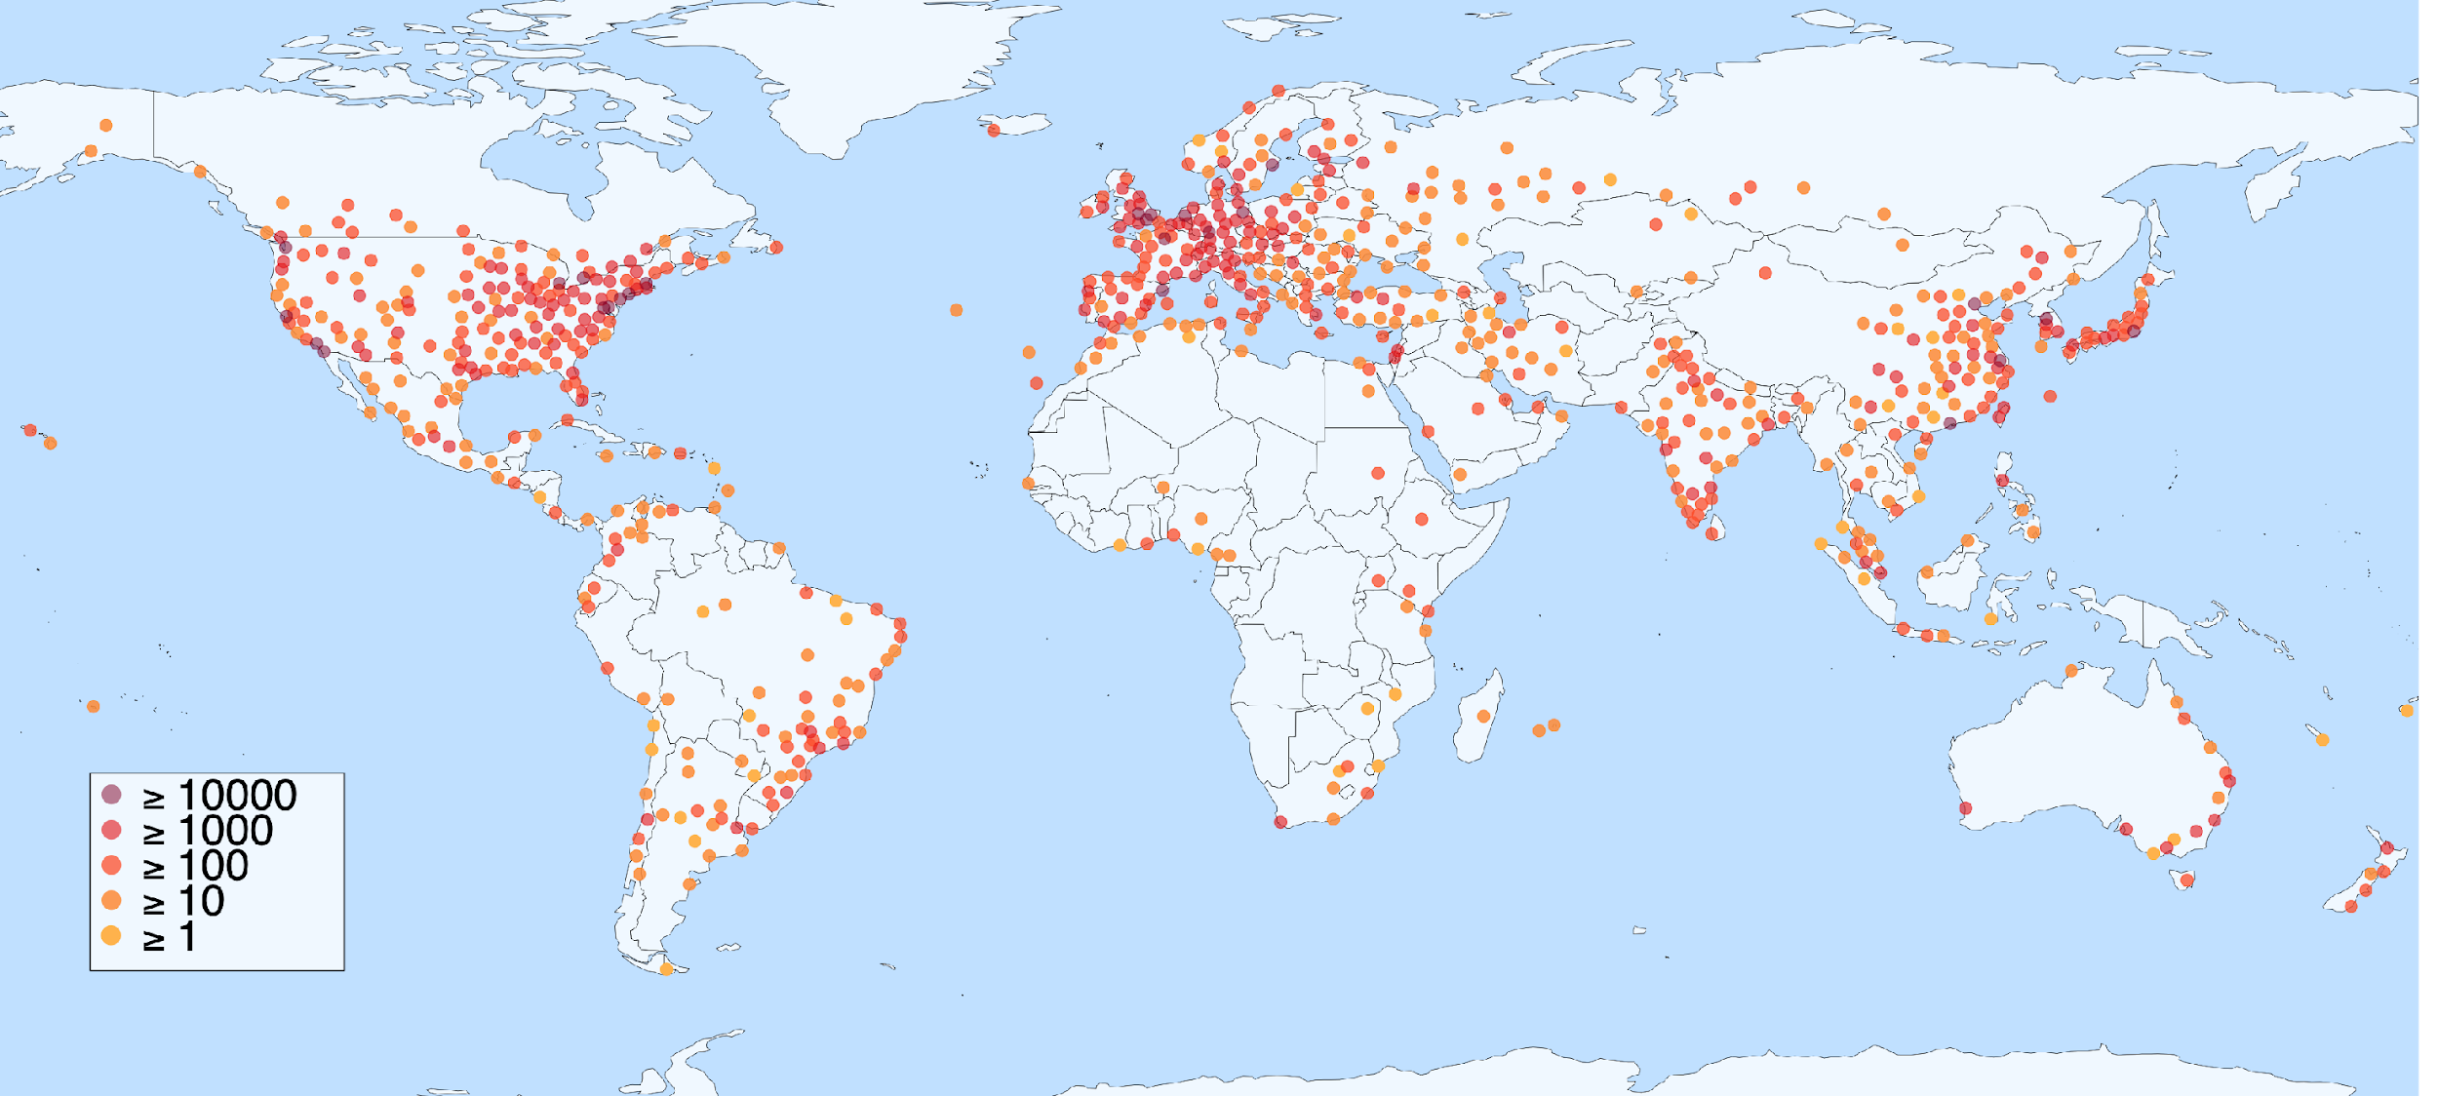
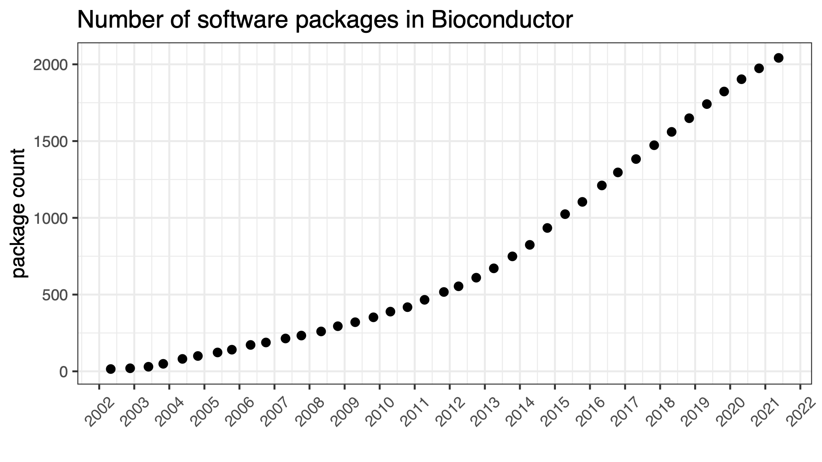
Bioconductor reaches researchers worldwide, growing
from a single idea in 2001 to a global community
2001
Bioconductor founded
by Robert Gentleman
2020
Bioconductor Community Advisory Board (CAB) founded by Aedin Culhane and Matt Ritchie
Site users - per location
10,000s users
>60,000 papers citing Bioconductor

Slide 4
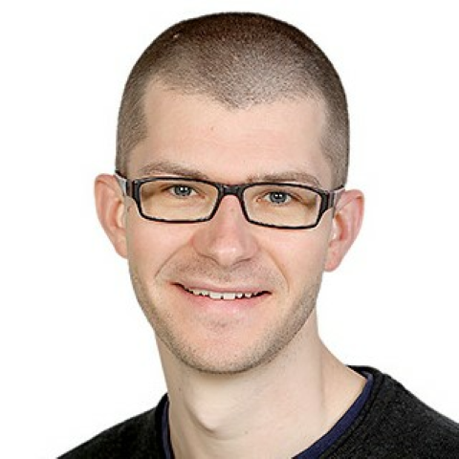
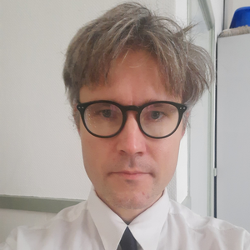
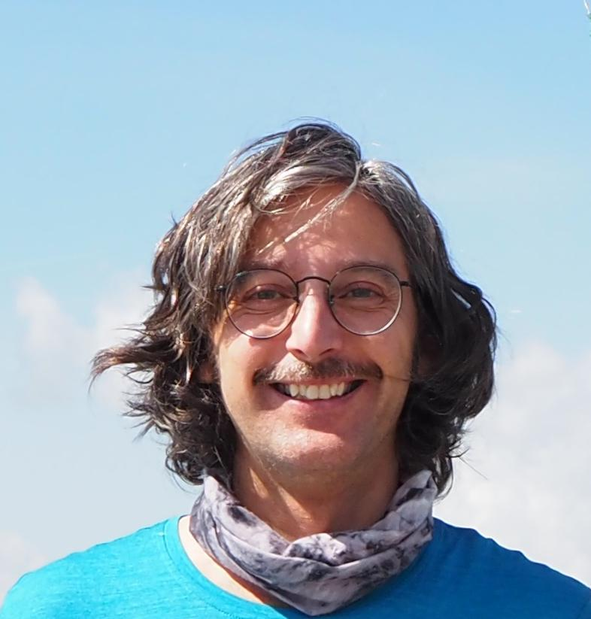
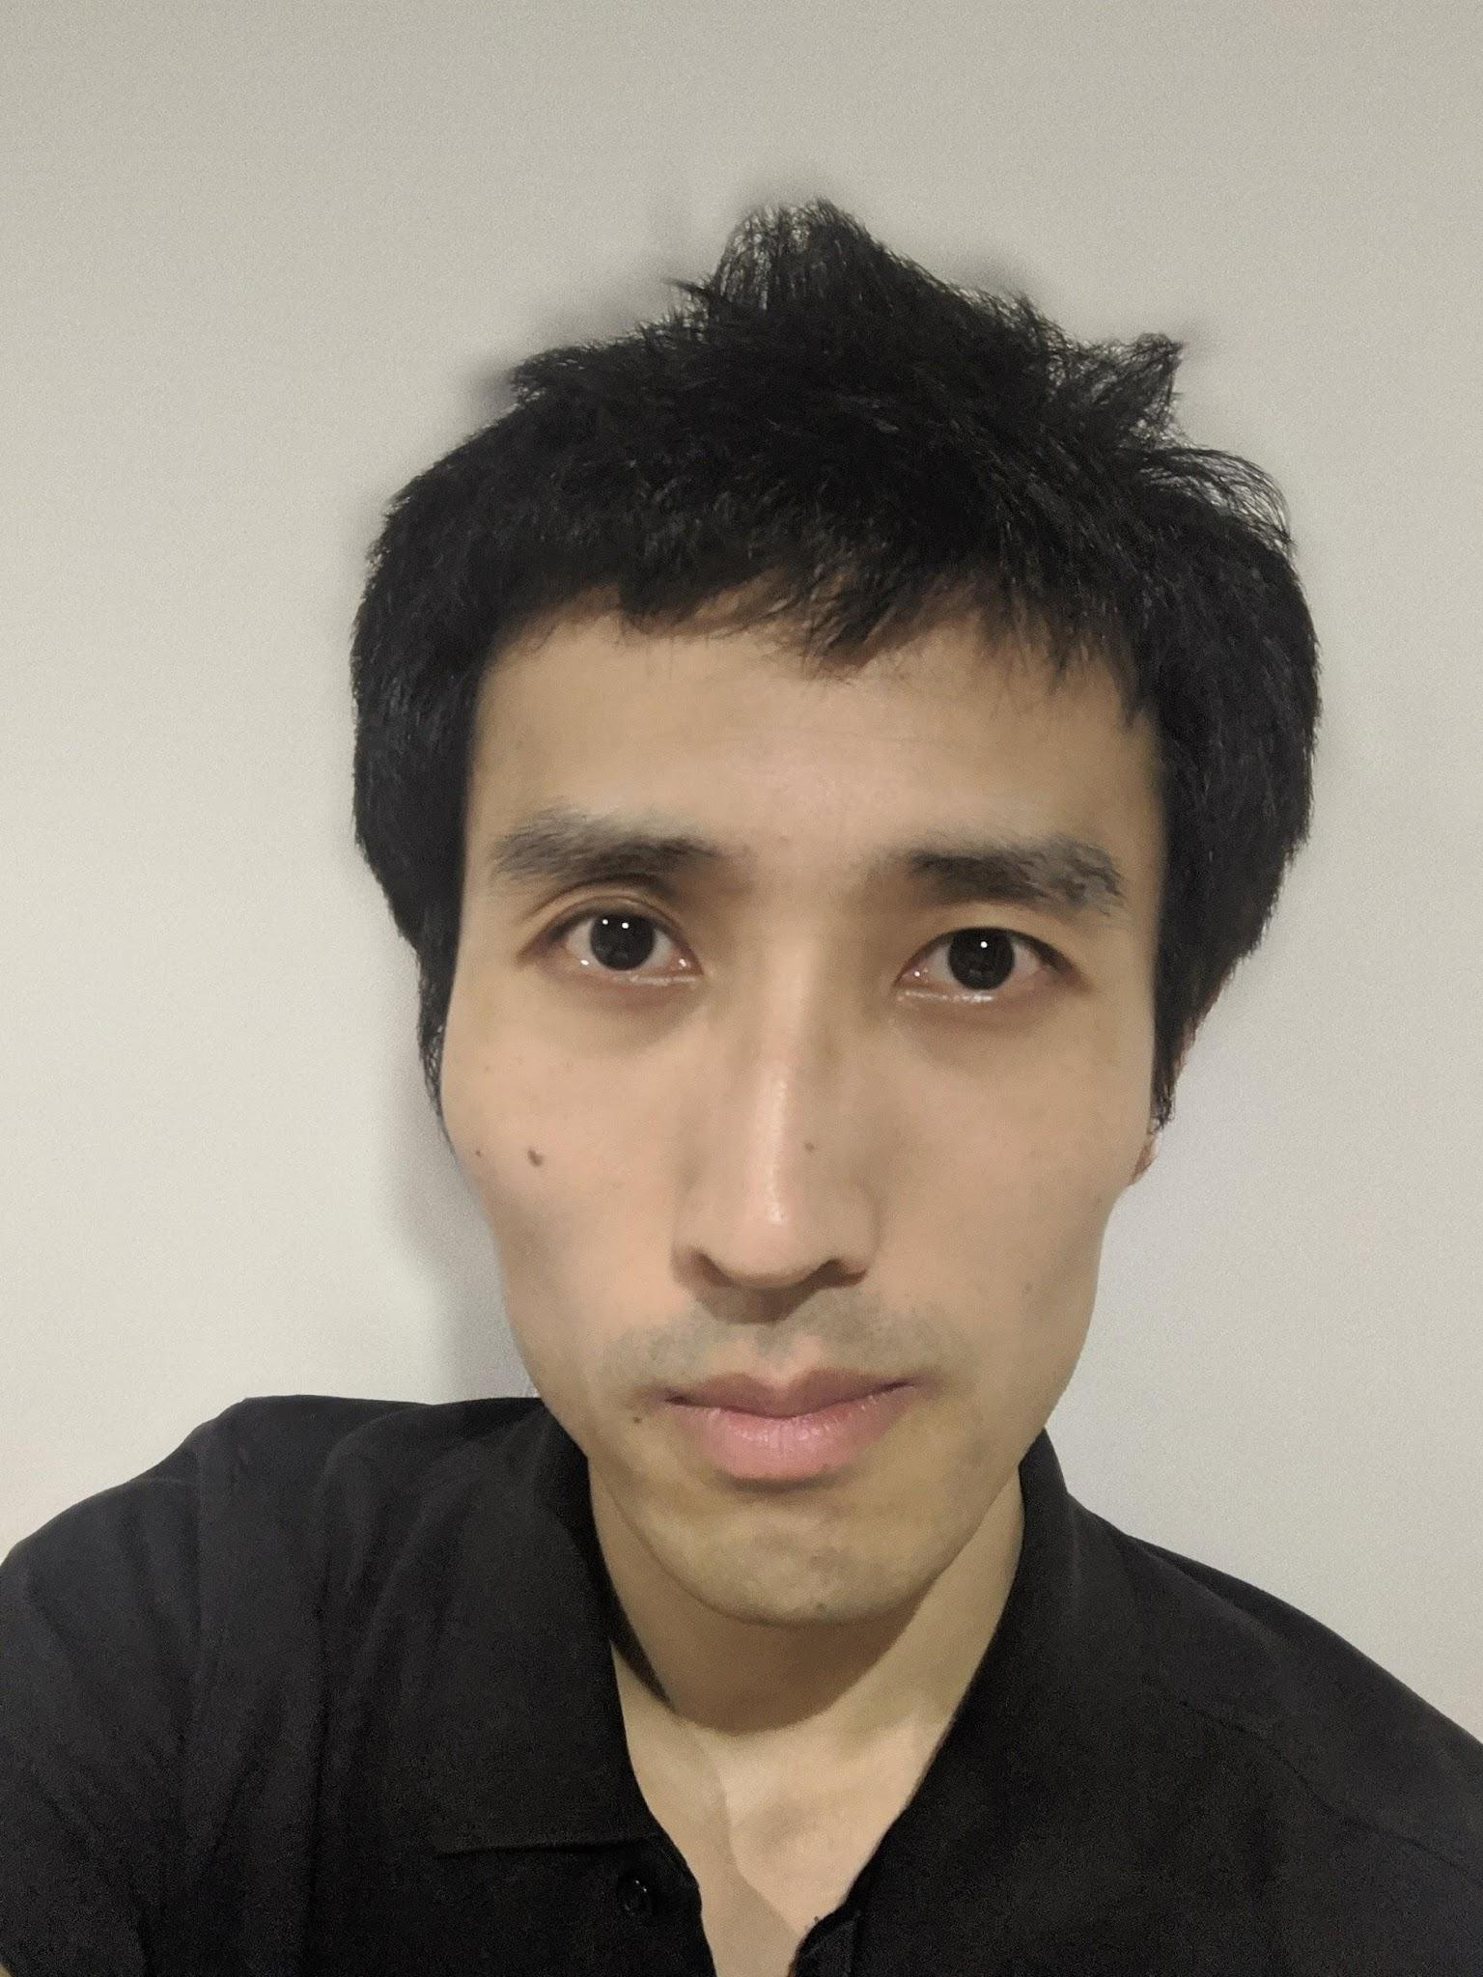
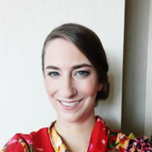
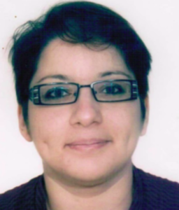
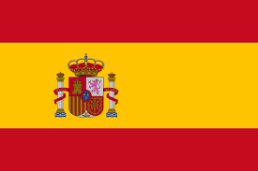
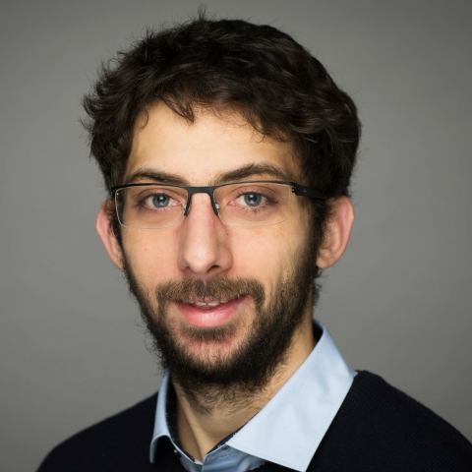
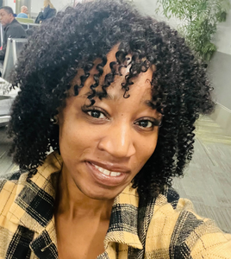
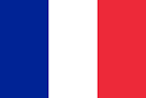
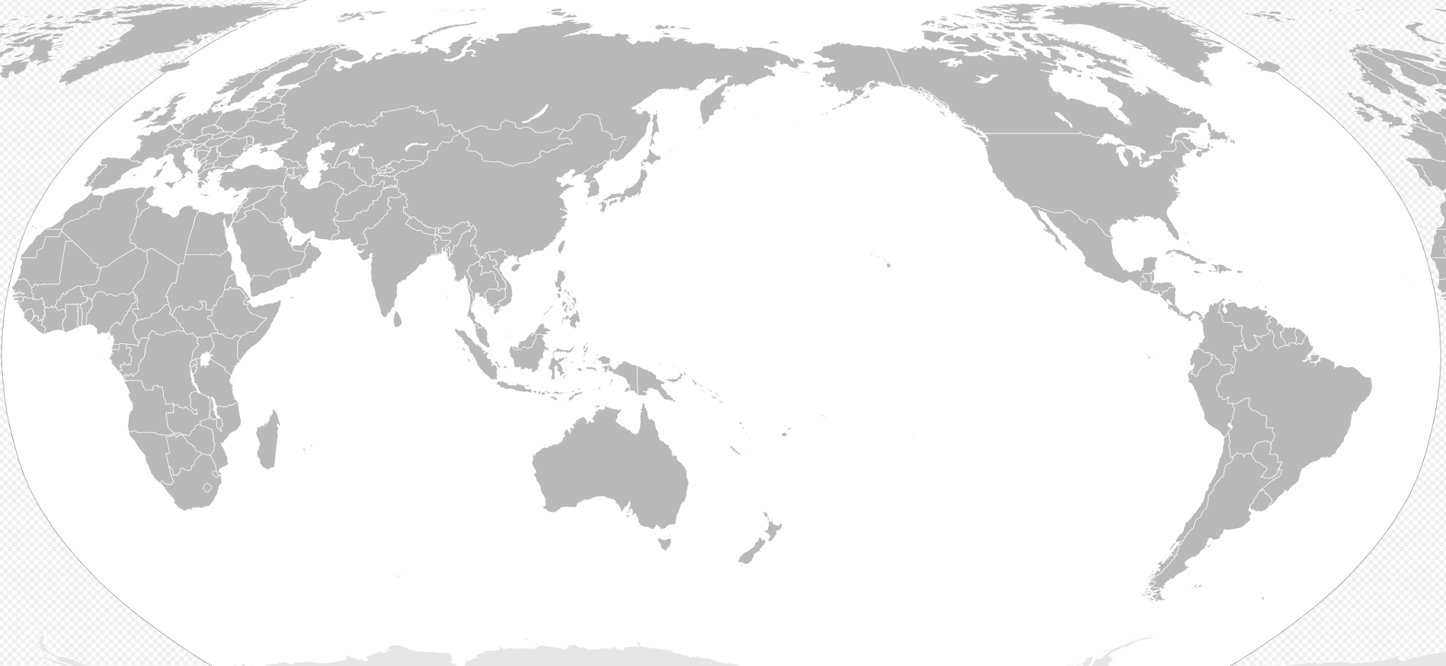
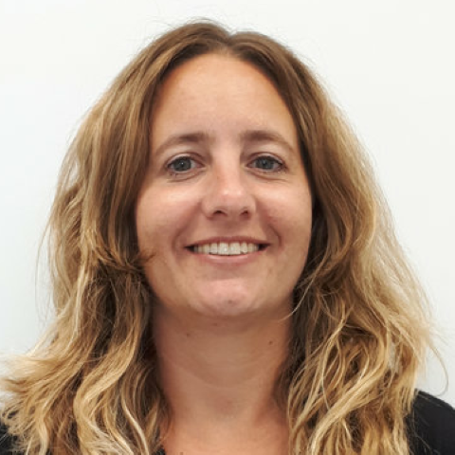
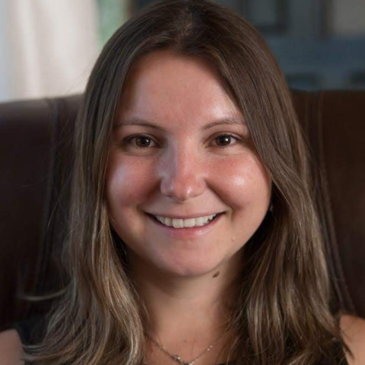
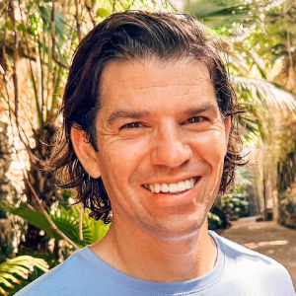
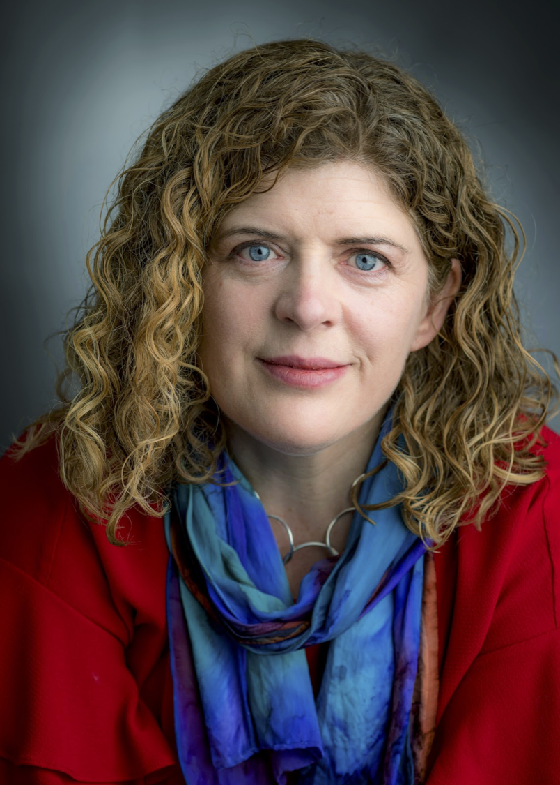
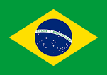
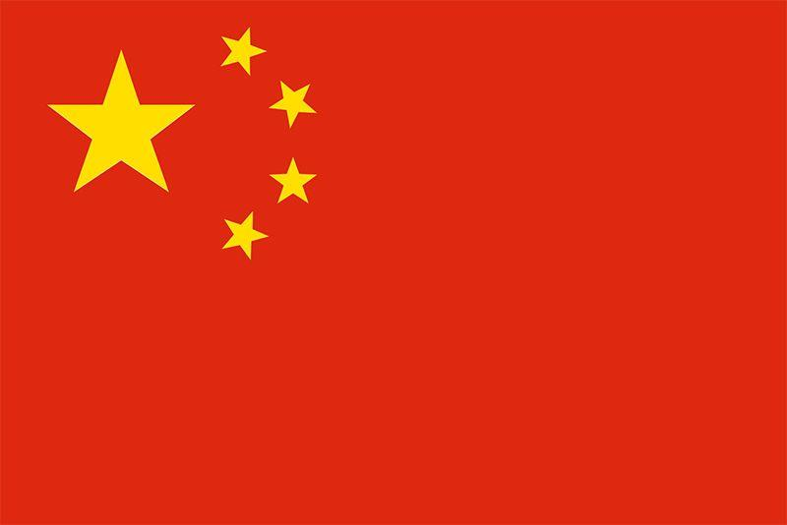
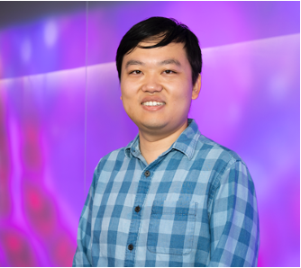
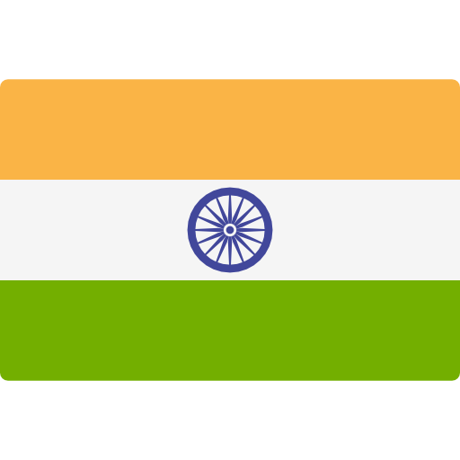
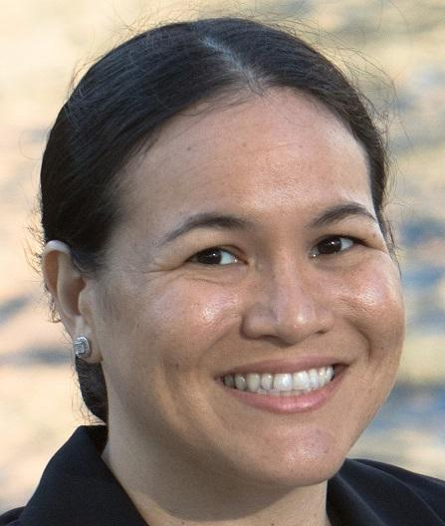
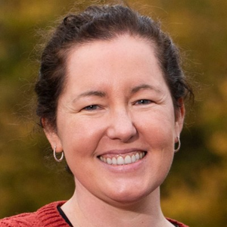
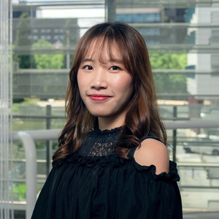
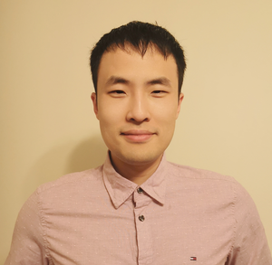
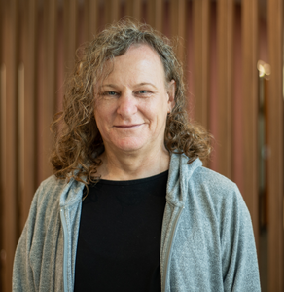
Bioconductor Community Advisory Board (CAB) globally champions the mission of open-source in bioinformatics
Johannes Rainer
Eurac Research, Italy
Kozo Nishida
TUAT, Japan
Lori Shepherd
Roswell Park Comprehensive Cancer Center, USA
Hedia Tnani Lieber Institute for Brain Development
Kevin Rue-Albrecht
University of Oxford, UK
Mike Smith
EMBL, Germany
Leo Lahti
University Turku, Finland
Jordana Muwanguzi, Northeastern University, USA
Estefania Mancini Centre for Genomic Regulation, Spain
Enis Afgan,
Johns Hopkins University, USA.
Aedin Culhane, University of Limerick, Ireland
Daniela Cassol
Lawrence Berkeley
National Lab, USA
Luyi Tian, Guangzhou Laboratory, China.
Janani Ravi,
University of Colorado Anschutz Medical Campus, USA.
Maria Doyle, University of Limerick, Ireland
Nicole Ortogero
NanoString Technologies,
Seattle, USA
Stevie Pederson, Telethon Kids Institute, Australia
Jiefei Wang,
University of Texas Medical Branch, USA.
Umar Ahmad
Bauchi State University,
Nigeria
Xueyi Dong, WEHI, Australia
Mengbo Li, WEHI, Australia
https://www.bioconductor.org/about/community-advisory-board/
Notes:
World map from https://commons.wikimedia.org/wiki/File:BlankMap-World-162E.svg

Slide 5
CAB supports many Bioconductor working groups
Code of conduct
Conference planning
Cloud methods
Developers training
Education
Governance
Mass spectrometry for proteomics and metabolomics
Multilingual
Package review
Privacy
Publication
Recommended classes and methods
Spatial and multi-omics
Industry
Website
Social media
https://workinggroups.bioconductor.org/
Notes:
Working groups in red are mentioned in this talk

Slide 6
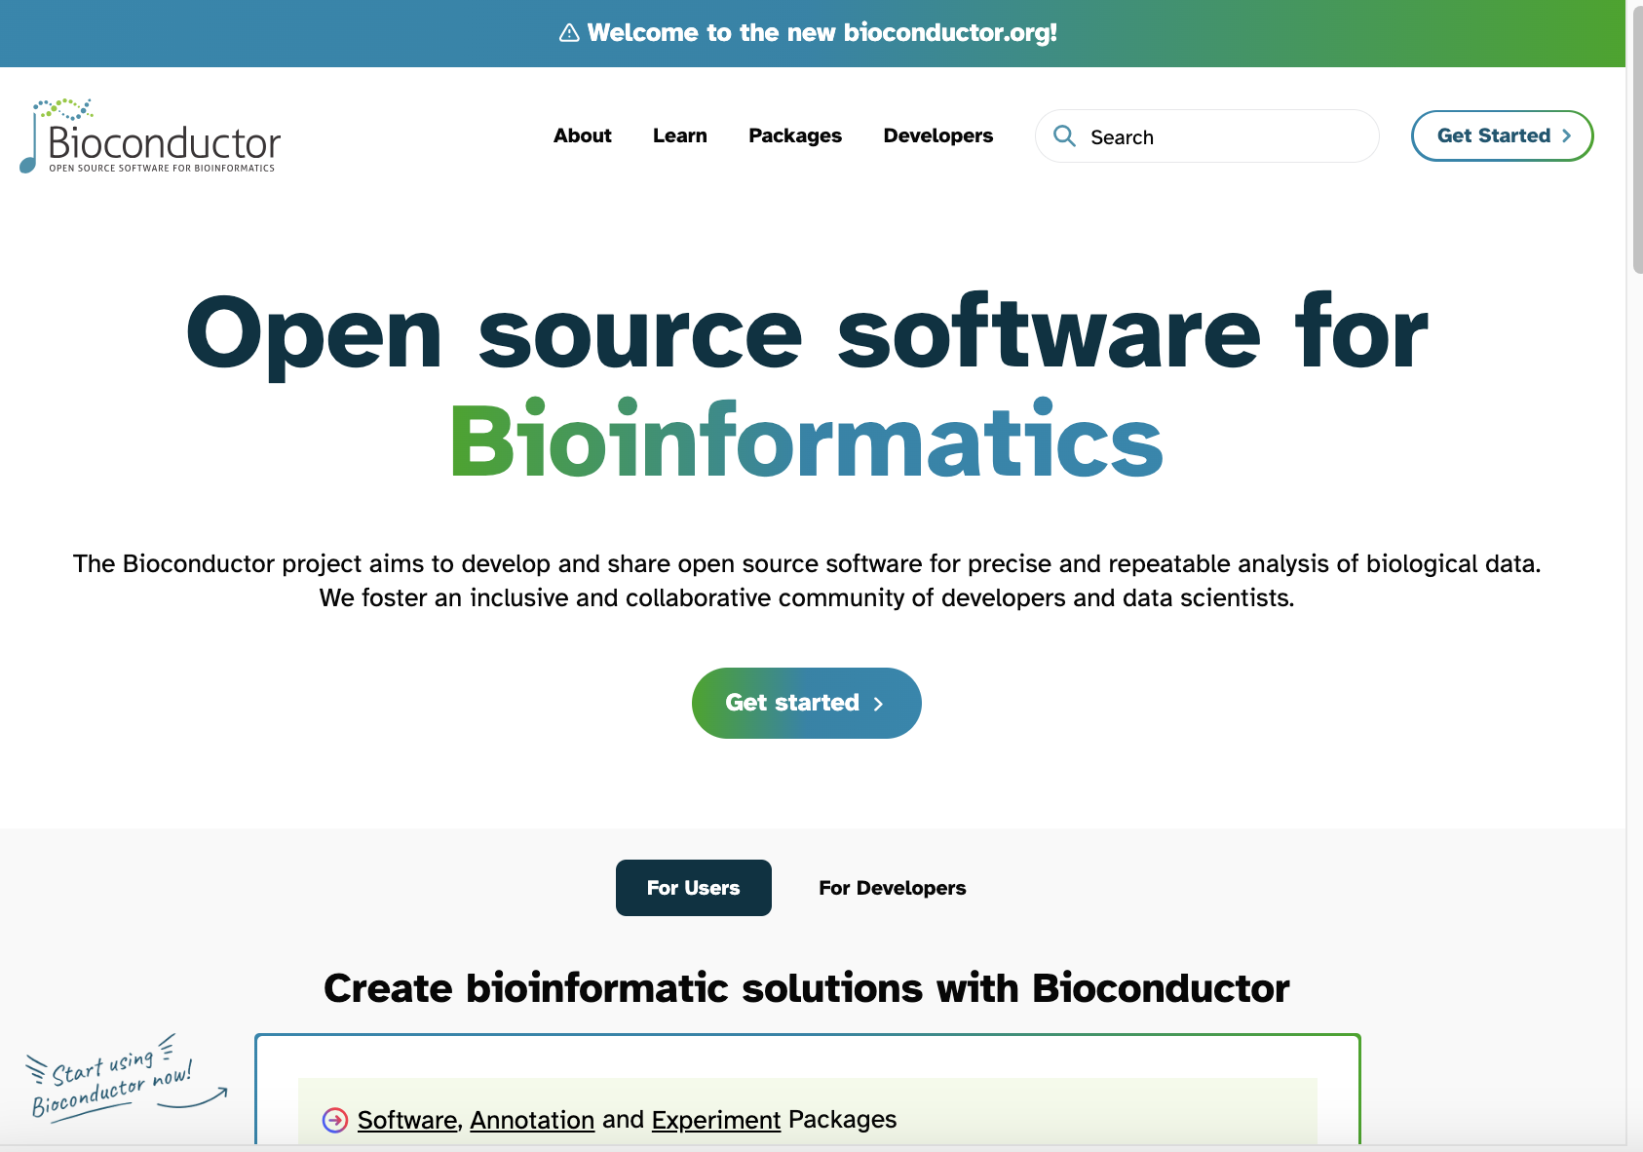
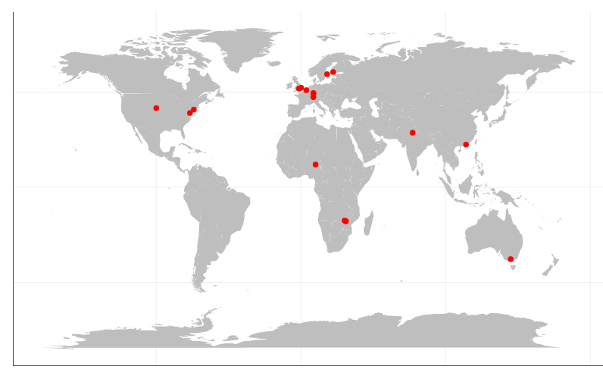
It was challenging to find funding for the Community Manager position, but the CAB's efforts succeeded and enabled important projects
1) Website redesign
to increase accessibility for new users and those with disabilities
2) Bioconductor Carpentries Program to train a diverse pool of instructors around the world, 18 so far

Slide 7
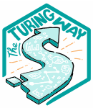
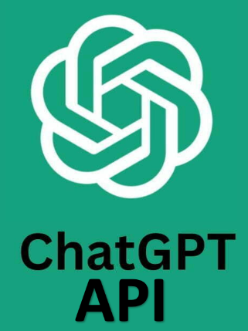
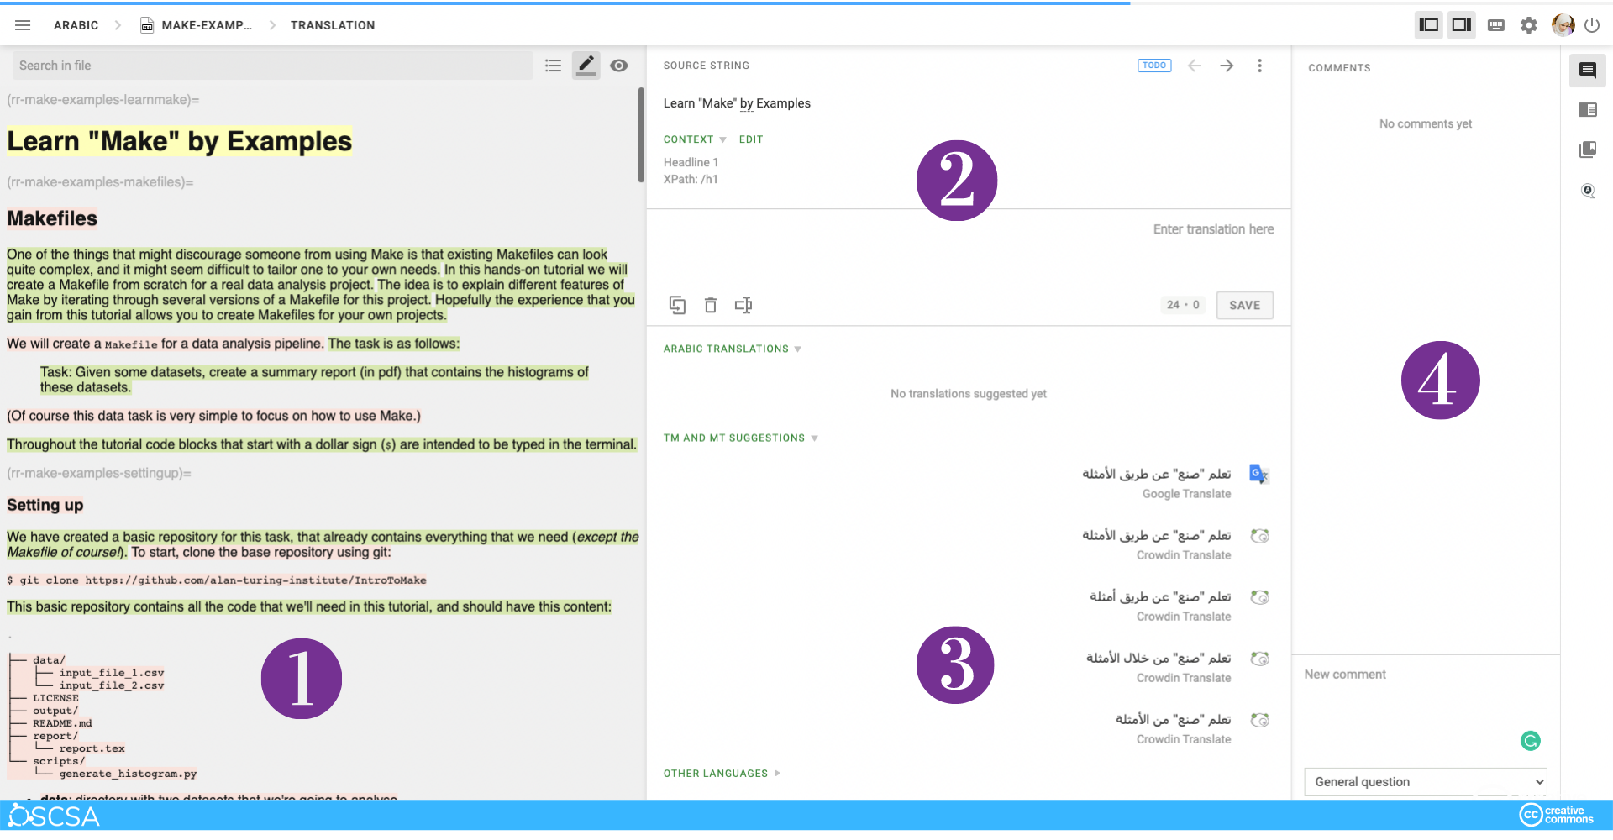
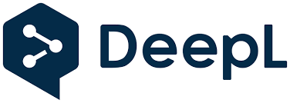
With the award, we plan to break down educational barriers, expanding outreach through AI-assisted translation for learners worldwide
https://the-turing-way.netlify.app/community-handbook/translation/translation-hello-crowdin
Thank You!

