Slide 1
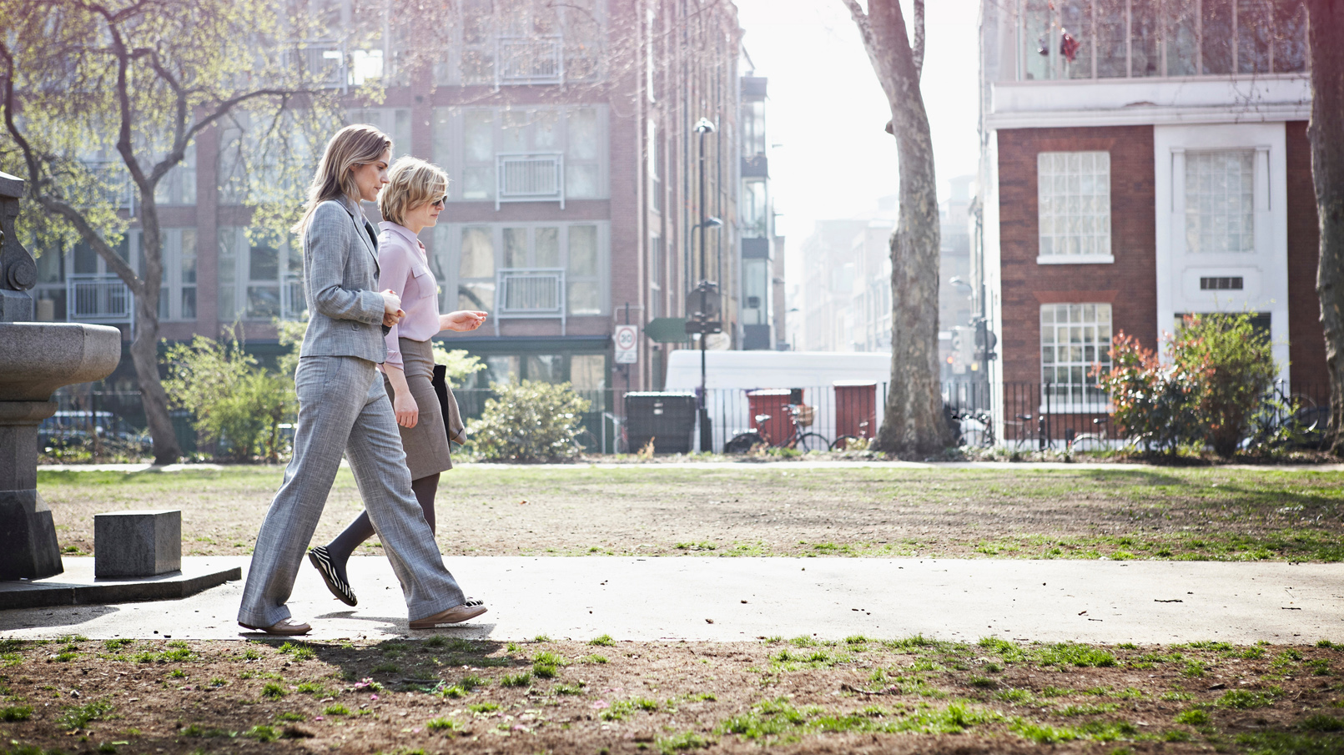
Moments of Wellbeing

Slide 2
Using wellbeing to reconnect with our staff & environment
Overview: small-scale initiative
Pilot small-scale health and wellbeing face to face initiatives (walk and talks) to reconnect with other staff and our environment
During work time – not lunch
Piloting a new meeting model
Get back out into nature
Time to disconnect from IT

Slide 3
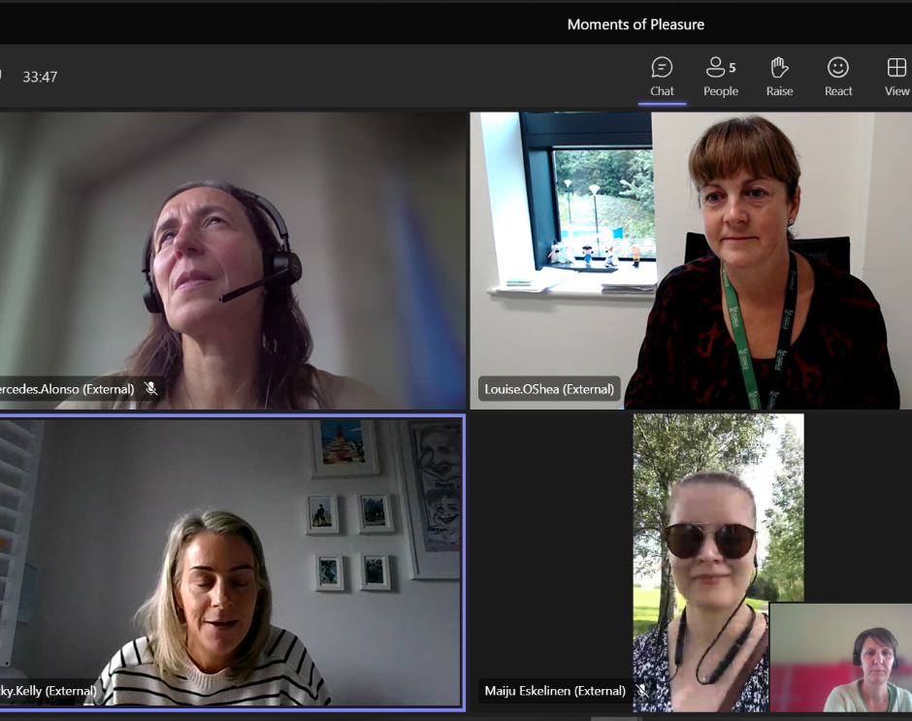
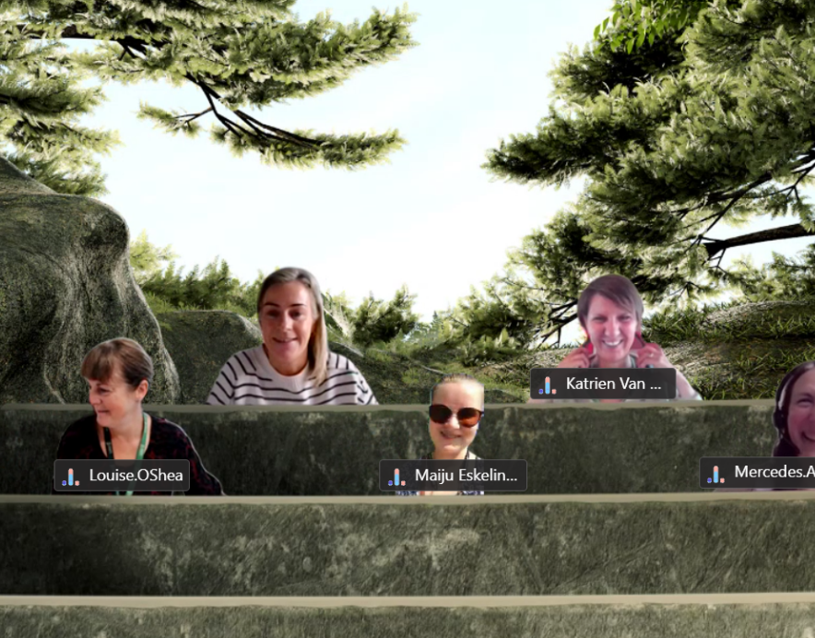
Working process
1st meeting in August '23 to reflect on the physical part of the BIP and to get started on our project
The walk and talks were arranged individually by group members
Excel template to write down feedback and reflections
Further meetings over summer/autumn to update progress and reflect on how it’s going

Slide 4
How we did it...
Total 10 Walk & Talk meetings between August & October 2023:
Traditional walk and talks
Bike meetings
Campus tours / sustainability
From one-on-one meetings to bigger groups
Both unstructured conversations, and meetings with more preparation
Possibility to continue the meeting indoors afterwards

Slide 5
The impact and implementation of the initiative at our universities
Spreading information about the walk and talk format to get more people excited about the idea
Wellbeing of individuals involved – positive feedback
Learning more about our own campus and showcasing it to others
Raised awareness of campus sustainability
Engaging with nature and taking time to 'stop'

Slide 6
What have we learned?
Conversations are more honest and authentic
Ideas flow more freely
Make personal connections
Walk and talk format works well for informal work conversations
There are challenges and limitations

Slide 7
Reflections on the road ahead for our initiative – at our universities and the possibility of spreading the idea to others?
Initiative is easy to implement on an individual level
What is needed is communication on the possibility
Easiest form: join a Teams/Zoom meeting or a webinar and go for a walk
Other possibilities?
Movement & stretching
Teaching / learning a new skill
Art tour
Learning something new about your campus

Slide 8
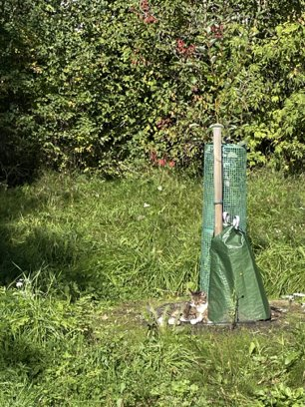
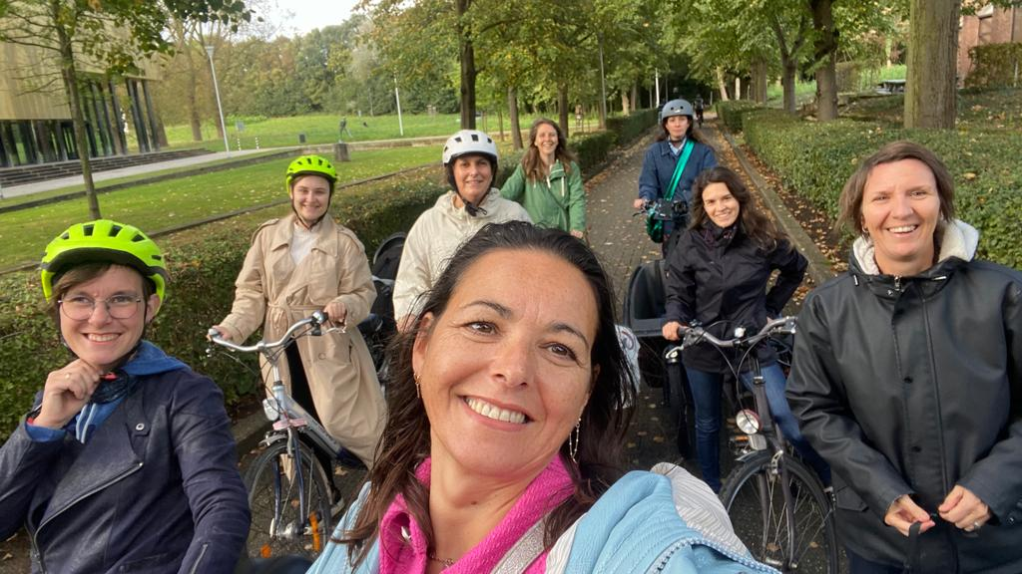
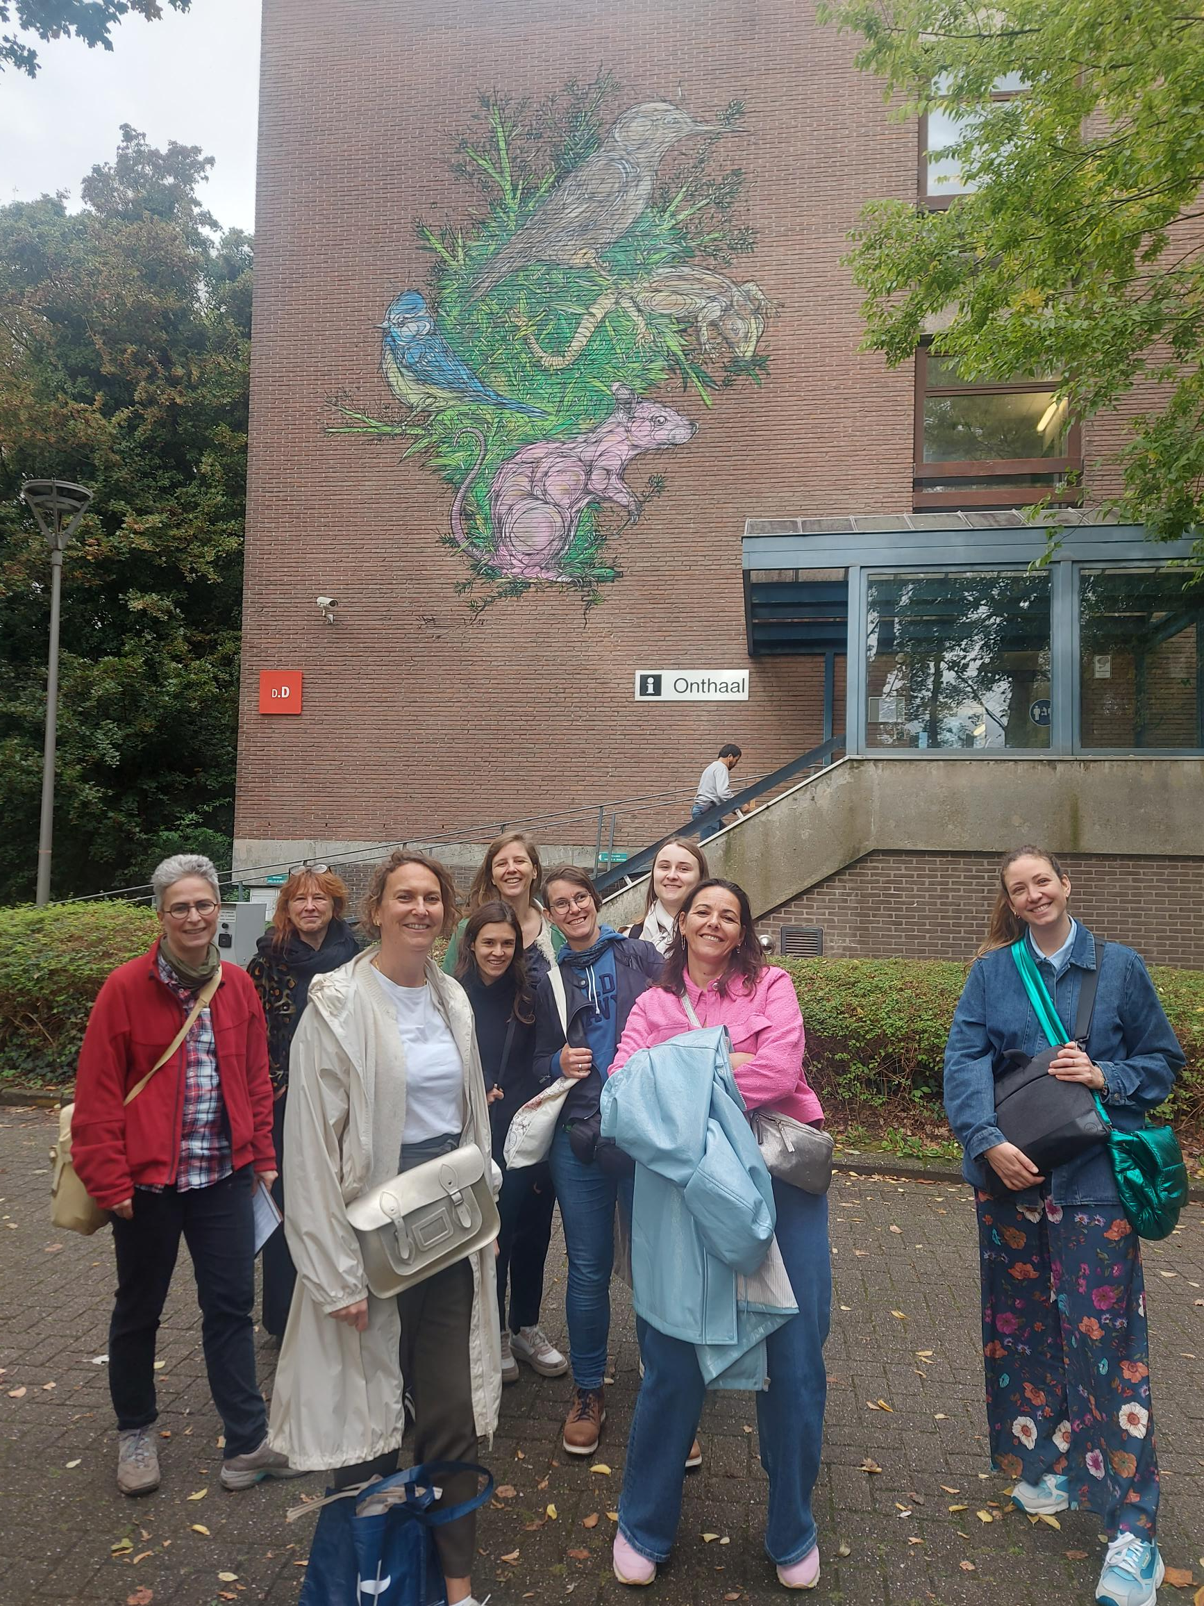
Walking, Biking & Talking...

Slide 9
Thank you! The Moments of Wellbeing Team

